Slide 1
VECTOR SPACE MODEL

Slide 2
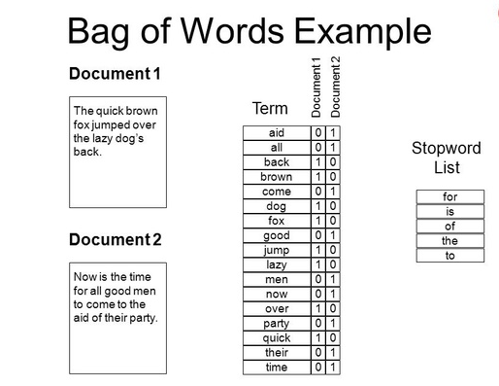
Bag of Words (BoW) Model
Vector representation doesn’t consider the ordering of words in a document
John is quicker than Mary and Mary is quicker than John
have the same vectors

Slide 3
Term frequency - tf
tf_{t,d} of term t in document d is defined as the number of times that t occurs in d.
We want to use tf when computing match scores. But how?
Raw term frequency is not what we want:
A document with 10 occurrences of the term is more relevant than a document with 1 occurrence of the term.
But not 10 times more relevant.
Relevance does not increase proportionally with term frequency.

Slide 4
Log-frequency weighting
The log frequency weight of term t in d is
0 → 0, 1 → 1, 2 → 1.3, 10 → 2, 1000 → 4, etc.
Score for a pair: sum over terms t in both q and d:
score
The score is 0 if none of the terms is present in the document.

Slide 5
Document frequency-df
Rare terms are more informative than frequent terms
Recall stop words
Consider a term in the query that is rare in the collection (e.g., arachnocentric)
A document containing such a term is more likely to be relevant than a document that doesn’t
But it’s not a sure indicator of relevance.
For frequent terms, we want high positive weights for words like high, increase, and line
But lower weights than for rare terms.
We will use document frequency (df) to capture this.

Slide 6
Inverse Document Frequency-idf
df_{t} is the document frequency of t: the number of documents that contain t
df_{t} is an inverse measure of the informativeness of t
df_{t} ≤ N
We define the idf (inverse document frequency) of t by
We use log (N/df_{t}) instead of N/df_{t} to “dampen” the effect of idf.
The base of the log is immaterial.

Slide 7
idf example, suppose N = 1 million
term | df_{t} | idf_{t}
calpurnia | 1
animal | 100
sunday | 1,000
fly | 10,000
under | 100,000
the | 1,000,000
There is one idf value for each term t in a collection.
Notes:
6 4 3 2 1 0

Slide 8
tf-idf weighting
The tf-idf weight of a term is the product of its tf weight and its idf weight.
Best known weighting scheme in information retrieval
Increases with the number of occurrences within a document
Increases with the rarity of the term in the collection

Slide 9
Score for a Match
There are many variants
How “tf” is computed (with/without logs)
Whether the terms in the query are also weighted
…

Slide 10
Binary → count → weight matrix
Each document is now represented by a real-valued vector of tf-idf weights ∈ R^{|V|}

Slide 11
Documents as vectors, Proximity
So we have a |V|-dimensional vector space
Terms are axes of the space
Documents are points or vectors in this space
Very high-dimensional: tens of millions of dimensions when you apply this to a web search engine
These are very sparse vectors - most entries are zero.
proximity = similarity of vectors
proximity ≈ inverse of distance
First cut: distance between two points
( = distance between the end points of the two vectors)
Euclidean distance? ……a bad idea….because Euclidean distance is large for vectors of different lengths.

Slide 12
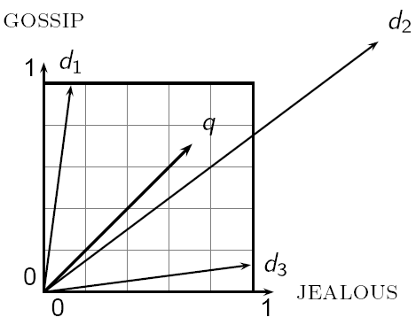
Why distance is a bad idea
The Euclidean distance between q
and d₂ is large even though the
distribution of terms in the query q and the distribution of
terms in the document d₂ are
very similar.

Slide 13
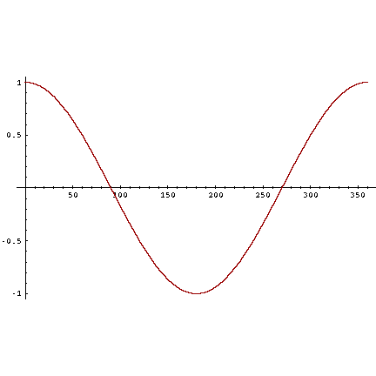
Angle instead of distance
Thought experiment: take a document d and append it to itself. Call this document d′.
“Semantically” d and d′ have the same content
Euclidean distance between the two documents can be quite large
Angle between the two documents is 0, corresponding to maximal similarity.
Cosine is a monotonically decreasing function for the interval [0º, 180º]

Slide 14
Length normalization
A vector can be (length-) normalized by dividing each of its components by its length – for this we use the L₂ norm:
Dividing a vector by its L₂ norm makes it a unit (length) vector
(on surface of unit hyper-sphere)
Effect on the two documents d and d′ (d appended to itself) from earlier slide: they have identical vectors after length-normalization.
Long and short documents now have comparable weights

Slide 15
Cosine Similarity (for length-normalized vectors)
Dot product
Unit vectors
For length-normalized vectors, cosine similarity is simply the dot product (or scalar product)
q_{i} is the tf-idf weight of term i in the q
d_{i} is the tf-idf weight of term i in the d
cos(q,d) is the cosine similarity of q and d … or,
equivalently, the cosine of the angle between q and d.
Notes:
See Law of Cosines (Cosine Rule) wikipedia page

Slide 16
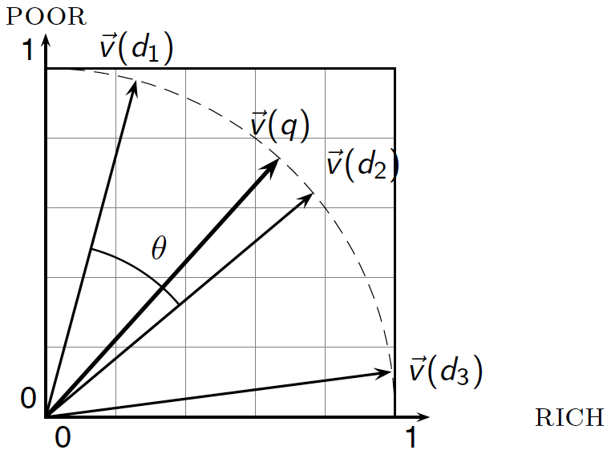
Cosine Similarity

Slide 17
Cosine similarity amongst 3 documents
How similar are
the novels
SaS: Sense and
Sensibility
PaP: Pride and
Prejudice, and
WH: Wuthering
Heights?
term | SaS | PaP | WH
affection | 115 | 58 | 20
jealous | 10 | 7 | 11
gossip | 2 | 0 | 6
wuthering | 0 | 0 | 38
Term frequencies (counts)
Note: To simplify this example, we don’t do idf weighting.

Slide 18
3 documents example contd.
Log frequency weighting
After length normalization
term | SaS | PaP | WH
affection | 3.06 | 2.76 | 2.30
jealous | 2.00 | 1.85 | 2.04
gossip | 1.30 | 0 | 1.78
wuthering | 0 | 0 | 2.58
term | SaS | PaP | WH
affection | 0.789 | 0.832 | 0.524
jealous | 0.515 | 0.555 | 0.465
gossip | 0.335 | 0 | 0.405
wuthering | 0 | 0 | 0.588
cos(SaS,PaP) ≈
0.789 × 0.832 + 0.515 × 0.555 + 0.335 × 0.0 + 0.0 × 0.0
≈ 0.94
cos(SaS,WH) ≈ 0.79
cos(PaP,WH) ≈ 0.69
Why do we have cos(SaS,PaP) > cos(SaS,WH)?

Slide 19
Problems – High Dimensionality
Term-document matrices are very large
But the number of topics that people talk about is small (in some sense)
Clothes, movies, politics, …
Can we represent the term-document space by a lower dimensional latent space?

Slide 20
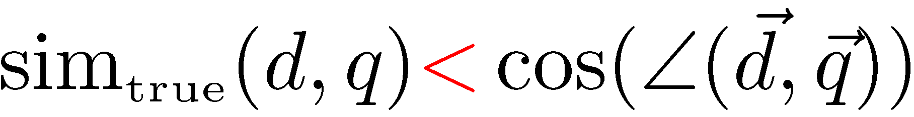
Problems - Lexical Semantics
Ambiguity and association in natural language
Polysemy: Words often have a multitude of meanings and different types of usage (more severe in very heterogeneous collections).
The vector space model is unable to discriminate between different meanings of the same word.

Slide 21
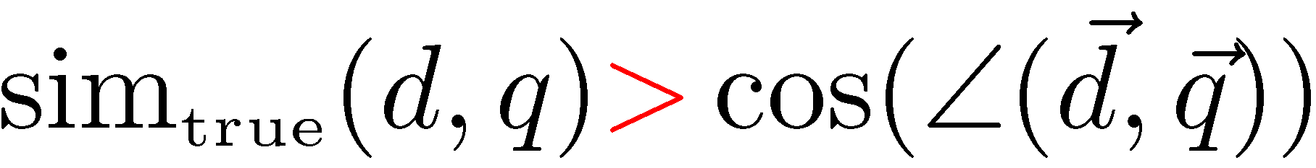
Problems - Lexical Semantics
Synonymy: Different terms may have identical or similar meanings (weaker: words indicating the same topic).
No associations between words are made in the vector space representation.

Slide 22
Latent Semantic Indexing (LSI)

Slide 23
LSA
Perform a low-rank approximation of document-term matrix (typical rank 100-300)
General idea
Map documents (and terms) to a low-dimensional representation.
Design a mapping such that the low-dimensional space reflects semantic associations (latent semantic space).
Compute document similarity based on the inner product in this latent semantic space
Similar terms map to similar location in low dimensional space
Noise reduction by dimension reduction
Latent Semantic Indexing was developed at Bellcore (now Telcordia) in the late 1980s (1988). It was patented in 1989.
http://lsi.argreenhouse.com/lsi/LSI.html

Slide 24
LSA
But first:
What is the difference between LSI and LSA???
LSI refers to using it for indexing or information retrieval.
LSA refers to everything else.
LSA Idea (Deerwester et al):
“We would like a representation in which a set of terms, which by itself is incomplete and unreliable evidence of the relevance of a given document, is replaced by some other set of entities which are more reliable indicants. We take advantage of the implicit higher-order (or latent) structure in the association of terms and documents to reveal such relationships.”

Slide 25
LSA
Four basic steps
Rank-reduced Singular Value Decomposition (SVD) performed on matrix
all but the k highest singular values are set to 0
produces k-dimensional approximation of the original matrix (in least-squares sense)
this is the “semantic space”
Compute similarities between entities in semantic space (usually with cosine)

Slide 26
LSA
SVD
unique mathematical decomposition of a matrix into the product of three matrices:
two with orthonormal columns
one with singular values on the diagonal
tool for dimension reduction
similarity measure based on co-occurrence
finds optimal projection into low-dimensional space
can be viewed as a method for rotating the axes in n-dimensional space, so that the first axis runs along the direction of the largest variation among the documents
the second dimension runs along the direction with the second largest variation
and so on
generalized least-squares method

Slide 27
What it is
From term-doc matrix A, we compute the approximation A_{k.}
There is a row for each term and a column for each doc in A_{k}
Thus docs live in a space of k<<r dimensions
These dimensions are not the original axes
But why?
Notes:
Ak is an M x N matrix but of rank k (while A is an M x N matrix with rank r)

Slide 28
Performing the maps
Each row and column of A gets mapped into the k-dimensional LSI space, by the SVD.
Claim – this is not only the mapping with the best (Frobenius error) approximation to A, but in fact improves retrieval.
A query q is also mapped into this space, by
Query NOT a sparse vector.
Notes:
Measure distance of query vector to all the documents in LSS to rank them.

Slide 29
Performing the maps
A^{T}A is the dot product of pairs of documents A^{T}A ≈ A_{k}^{T}A_{k} = (U_{k}Σ_{k}V_{k}^{T})^{T} (U_{k}Σ_{k}V_{k}^{T}) = V_{k}Σ_{k}U_{k}^{T} U_{k}Σ_{k}V_{k}^{T} = (V_{k}Σ_{k}) (V_{k}Σ_{k}) ^{T}
Since V_{k} = A_{k}^{T}U_{k}Σ_{k}⁻¹ we should transform query q to q_{k} as follows

Slide 30
Singular Value Decomposition
For an M × N matrix A of rank r there exists a factorization
(Singular Value Decomposition = SVD) as follows:
M×M
M×N
V is N×N
The columns of U are orthogonal eigenvectors of AA^{T}.
The columns of V are orthogonal eigenvectors of A^{T}A.
Eigenvalues λ₁ … λ_{r} of AA^{T} are the eigenvalues of A^{T}A.
Singular values.
Notes:
rank = number of linearly independent rows or columns A = term document matrix
A^T A = doc-doc correlation (aij proportional to how correlated doc i is to docj)
A A^T = term-term correlation (aij proportional to how correlated term i is to term j)

Slide 31
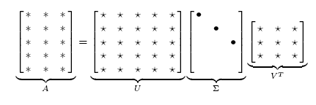
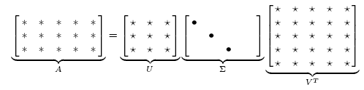
Singular Value Decomposition
Illustration of SVD dimensions and sparseness

Slide 32
SVD example
Let
Thus M=3, N=2. Its SVD is
Typically, the singular values arranged in decreasing order.

Slide 33

Low-rank Approximation
SVD can be used to compute optimal low-rank approximations.
Approximation problem: Find A_{k} of rank k such that
A_{k} and X are both m×n matrices.
Typically, want k << r.
Frobenius norm
Notes:
Find closest (according to L2 norm) X of rank k approximating A of rank r.

Slide 34
Low-rank Approximation
Solution via SVD
set smallest r-k
singular values to zero
k
column notation: sum
of rank 1 matrices
Notes:
In text retrieval application, lower rank approximation maps 10,000 term-space into 200-dimensional space.
Instead of transmitting 10K x 1M doc/bit matrix, we can obtain 10K x 200 + 200 + 200 x 1M data compression,
or abstraction to better reflect concepts. Terms, documents and queries mapped into 200-dim space and
distance/similarity compared/ranked gives better results.

Slide 35
Reduced SVD
If we retain only k singular values, and set the rest to 0, then we don’t need the matrix parts in red
Then Σ is k×k, U is M×k, V^{T} is k×N, and A_{k} is M×N
This is referred to as the reduced SVD
It is the convenient (space-saving) and usual form for computational applications
k
Notes:
In text retrieval application, lower rank approximation maps 10,000 term-space into 200-dimensional space.
Instead of transmitting 10K x 1M doc/bit matrix, we can obtain 10K x 200 + 200 + 200 x 1M data compression,
or abstraction to better reflect concepts. Terms, documents and queries mapped into 200-dim space and
distance/similarity compared/ranked gives better results.

Slide 36
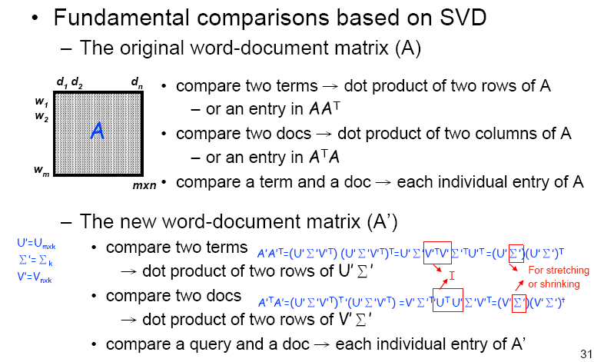
Computing Similarity in LSI

Slide 37
Approximation error
How good (bad) is this approximation?
It’s the best possible, measured by the Frobenius norm of the error:
where the σ_{i} are ordered such that σ_{i} ≥ σ_{i+1}.
Suggests why Frobenius error drops as k increases.

Slide 38
SVD Low-rank approximation
Whereas the term-doc matrix A may have M=50000, N=10 million (and rank close to 50000)
We can construct an approximation A₁₀₀ with rank 100.
Of all rank 100 matrices, it would have the lowest Frobenius error.
Great … but why would we??
Answer: Latent Semantic Indexing
C. Eckart, G. Young, The approximation of a matrix by another of lower rank. Psychometrika, 1, 211-218, 1936.

Slide 39
Example
d1 : Romeo and Juliet.
d2 : Juliet: O happy dagger!
d3 : Romeo died by dagger.
d4 : “Live free or die”, that’s the New-Hampshire’s motto.
d5 : Did you know, New-Hampshire is in New-England.
and a search query: dies, dagger.

Slide 40
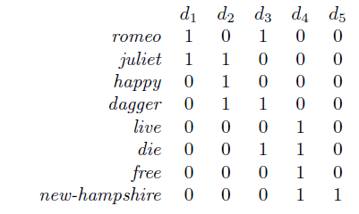
Example

Slide 41
Example
B = A^{T}A is the document-document matrix.
If documents i and j have b words in common then B[i, j] = b.
C = AA^{T} is the term-term matrix.
If terms i and j occur together in c documents then C[i, j] = c.
Clearly, both B and C are square and symmetric;
B is an m × m matrix, whereas C is an n × n matrix.

Slide 42
M×M
M×N
V is N×N
S is the matrix of the eigenvectors of B
U is the matrix of the eigenvectors of C
is the diagonal matrix of the singular values obtained as square roots of the eigenvalues of B

Slide 43
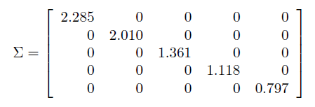
the singular values along the diagonal are listed in descending order of their magnitude.
For small SVD calculations, you can use the BlueBit calculator at http://www.bluebit.gr/matrix-calculator

Slide 44
Some of the singular values are “too small” and thus “negligible.” ………….“too small” is usually determined empirically.
In LSI we ignore these small singular values and replace them by 0.
we only keep k singular values. Then will be all zeros except the first k entries along its diagonal.

Slide 45

we can reduce matrix into k which is an k ×k matrix containing only the k singular values
reduce S and U^{T} , into S_{k} and and U^{T}_{k} , to have k columns and rows, respectively.
Of course, all these matrix parts that we throw out would have been zeroed anyway by the zeros in .
A_{k} is again an m × n matrix.

Slide 46
Intuitively, the k remaining ingredients of the eigenvectors in S and U correspond to k “hidden concepts” where the terms and documents participate. The terms and documents have now a new representation in terms of these hidden concepts. Namely, the terms are represented by the row vectors of the m × k matrix

Slide 47

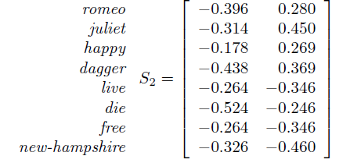

Example (Cont.)
Terms representation
Documents representation

Slide 48
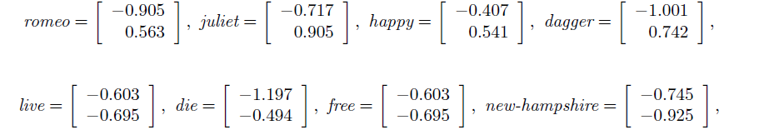
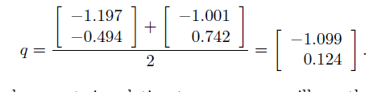

Slide 49
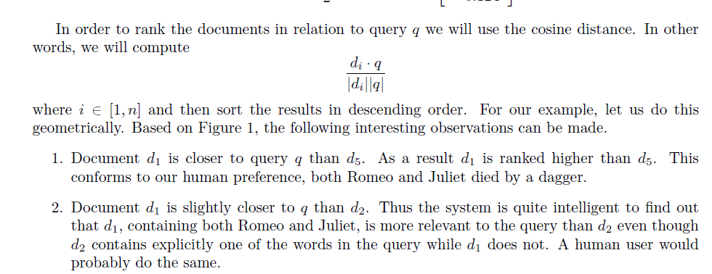

Slide 50
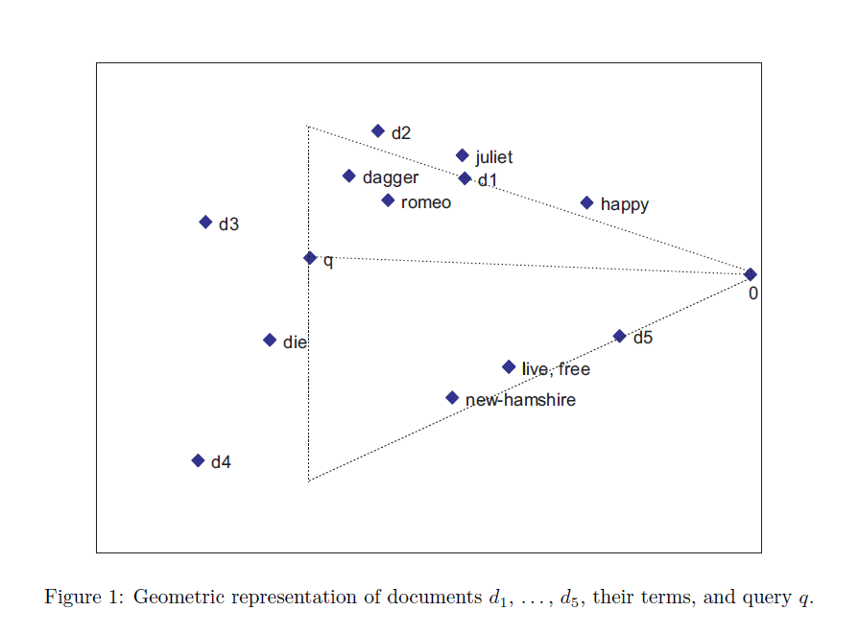

Slide 51
Empirical evidence
Precision at or above median TREC precision
Top scorer on almost 20% of TREC topics
Slightly better on average than straight vector spaces
Effect of dimensionality:
Dimensions | Precision
250 | 0.367
300 | 0.371
346 | 0.374

Slide 52
But why is this clustering?
We’ve talked about docs, queries, retrieval and precision here.
What does this have to do with clustering?
Intuition: Dimension reduction through LSI brings together “related” axes in the vector space.

Slide 53
Intuition from block matrices
N documents
Block 1
What’s the rank of this matrix?
Block 2
0’s
M
terms
…
0’s
Block k
= Homogeneous non-zero blocks.

Slide 54
Intuition from block matrices
N documents
Block 1
Block 2
0’s
M
terms
…
0’s
Block k
Vocabulary partitioned into k topics (clusters); each doc discusses only one topic.

Slide 55
Intuition from block matrices
Likely there’s a good rank-k
approximation to this matrix.
wiper
Block 1
tire
V6
Block 2
Few nonzero entries
…
Few nonzero entries
Block k
car
1
0
automobile
0
1
Notes:
What’s the best rank-k approximation to this matrix?

Slide 56
Simplistic picture
Topic 1
Topic 2
Topic 3

Slide 57
Some wild extrapolation
The “dimensionality” of a corpus is the number of distinct topics represented in it.
More mathematical wild extrapolation:
if A has a rank k approximation of low Frobenius error, then there are no more than k distinct topics in the corpus.

Slide 58
LSI has many other applications
In many settings in pattern recognition and retrieval, we have a feature-object matrix.
For text, the terms are features and the docs are objects.
Could be opinions and users …
This matrix may be redundant in dimensionality.
Can work with low-rank approximation.
If entries are missing (e.g., users’ opinions), can recover if dimensionality is low.
Powerful general analytical technique
Close, principled analog to clustering methods.

